Slide 1
B-tree & K-D tree implementation..

Slide 2
Project Roadmap:
ROLE DISTRIBUTION
BOUNDARY CASES DEFINED
DISCUSSION ON EFFICIENT DESIGN AND TIME COMPLEXITIES
TEST CASES DOCUMENTED.
14
19
20
24
25
CODE DEVELOPMENT COMPLETED.

Slide 3
PROJECT MANAGER: SOMASEKHARA
BUSINESS ANALYST: TEJASHREE
B-TREE
DEVELOPERS:
SUPRITHA
PRANAAV A
DHANVANYAA
VARSHA C
TESTERS:
ROHITH KANNA
RAHUL KARTIK
K-D TREE
DEVELOPERS:
PRANAV B
SANTHOSH
TESTER:
RITIKA

Slide 4
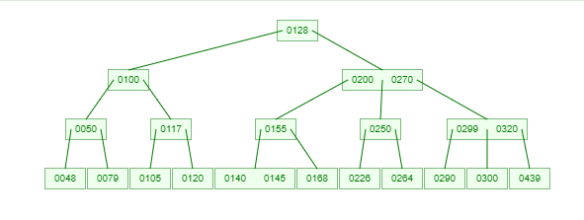
B-trees are essential data structures renowned for efficiently storing and managing sorted data, particularly in scenarios involving large datasets. Their design revolves around maintaining a balanced hierarchical structure, ensuring predictable performance across various operations like search, insertion, and deletion. At their core, B-trees organize data in nodes, with each node containing multiple keys arranged in sorted order and pointers to child nodes. This arrangement enables efficient traversal and search operations, as keys can be quickly located within each node. One of the key features of B-trees is their ability to remain balanced, with all leaf nodes situated at the same level. This balance is crucial for maintaining consistent time complexity for operations even as the dataset grows.
B-TREE

Slide 5
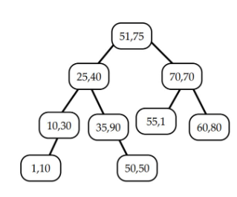
KD-trees, or k-dimensional trees, are fundamental data structures used for partitioning multidimensional space. They offer a sophisticated approach to organizing data, especially in scenarios involving multiple dimensions. Each node within a KD-tree represents a region within the multidimensional space, split along different dimensions in a binary tree structure. The construction of KD-trees is recursive, with careful consideration given to selecting split dimensions and values. These decisions are pivotal in maintaining the balance of the tree, ensuring efficient search and query operations. The alternating splitting along different dimensions creates a balanced binary tree, with nodes representing distinct regions in the multidimensional space. .
K-D TREE

Slide 6
Performance Trade-offs: B-tree vs KD-tree
 | B-TREE | KD-TREE
INSERTION | O(Log n) | O(log n) (average), O(n) (worst case)
SEARCH | O(Log n) | O(log n) (average), O(n) (worst case)
DELETION | O(Log n) | O(log n) (average), O(n) (worst case)
SPACE COMPLEXITY | O(n) | O(n)
BALANCING | Requires frequent rebalancing operations to maintain balance property. | KD-trees don't require rebalancing operations, but may become unbalanced depending on input data

Slide 7
Team contributions
B-TREE:
Varsha & Dhanvanyaa- Deletion.
Supritha & Pranaav A- Insertion, Search and Display.
Rahul & Rohith- Test Cases and Boundary Conditions for B-Tree.
K-D TREE:
Pranav B- Insertion And Search.
Santhosh- Deletion.
Ritika- Test Cases and Boundary Conditions For K-D Tree.
Tejashree- Created Documentation and Algorithms for Insertion, Deletion & Search for B-Tree and K-D tree.
SomaSekhara- Orchestrated Task Management and Presentation Preparation with Timely Execution.

Slide 8
BIBLIOGRAPHY
TITLE: Search and Insertion in K-Dimensional Tree
Source: GeeksforGeeks
Link: https://www.geeksforgeeks.org/search-and-insertion-in-k-dimensional-tree/
TITLE: Introduction of B-Tree
Source: GeeksforGeeks
Link: https://www.geeksforgeeks.org/introduction-of-b-tree-2/
TITLE: Delete Operation in B-Tree
Source: GeeksforGeeks
Link: https://www.geeksforgeeks.org/delete-operation-in-b-tree/?ref=lbp
TITLE: B-Tree Visualization
Source: University of San Francisco
Link: https://www.cs.usfca.edu/~galles/visualization/BTree.html

